Slide 1

MADAN MOHAN MALAVIYA UNIVERSITY OF TECHNOLOGY
GORAKHPUR
ACTIVE DIRECTORY ENUMERATION USING EMPIRE
Presented by:
YOGESH KUMAR PANDEY
Roll no.: 2024073074
M.C.A. 2nd Year (3rd Sem)
Under Supervision By:
Dr. PREETI SINGH
DEPT. of ITCA

Slide 2
CONTENTS
Introduction
Problem Statement
Learning Objectives
Technology/Tools Used
About the Attack
Implementation Overview
Key Enumeration Commands
Reasons behind the problem
Countermeasures
Workflow Demonstration
Conclusion
References

Slide 3
INTRODUCTION
Active Directory (AD) is crucial for enterprise identity management.
Often targeted by attackers post-compromise.
Empire is a post-exploitation framework for simulating attacker behavior.

Slide 4
PROBLEM STATEMENT
In modern enterprise networks, Active Directory (AD) is a critical component managing authentication, access control, and resource management.
However, it is often misconfigured or weakly secured, making it a primary target during internal network attacks.
This project demonstrates how Empire, a post-exploitation tool, can be used to enumerate Active Directory — revealing vulnerabilities and misconfigurations that attackers exploit.

Slide 5
LEARNING OBJECTIVES
Understand AD components and structure.
Install and use Empire and PowerView.
Simulate attacker behavior via agents.
Enumerate domain users, computers, GPOs, trusts.
Build custom virtual lab using VirtualBox.

Slide 6
TECHNOLOGY/TOOLS TO BE USED
Active Directory (Windows Server 2016)
Kali Linux (attacker machine)
Empire Framework (post-exploitation & enumeration)
VirtualBox (Lab hosting environment)
TryHackMe Lab Environment (for simulation)

Slide 7
ABOUT THE ATTACK
About AD Enumeration with Empire:
Active Directory Enumeration is the process of gathering information about users, groups, computers, domain trusts, and policies within an AD environment.
The Empire framework allows attackers to bypass detection, maintain persistent access, and automate AD data gathering using PowerShell-based agents.
The aim is to simulate how an attacker escalates privileges post-compromise and to raise awareness about securing internal systems.

Slide 8
IMPLEMENTATION OVERVIEW
Installed Kali Linux and Windows Server 2016 in VirtualBox.
Promoted Windows Server to Domain Controller.
Installed Empire on Kali and created listener.
Generated and ran stager on target.
Received agent callback and performed enumeration.

Slide 9
KEY ENUMERATION COMMANDS
Get Domain Users: get_user
Get Computers: get_computer
Get Logged-on Users: get_loggedon
Enumerate GPOs, OUs, and Trusts via PowerView modules.

Slide 10
WHAT ARE THE REASONS BEHIND THE PROBLEM
Why are AD Attacks Common?
Weak AD configurations
Lack of regular auditing & monitoring
Excessive user privileges (users having more rights than needed)
No segmentation — attackers can move laterally once inside
Unpatched vulnerabilities in Windows infrastructure
User awareness is low (phishing often gives initial access)

Slide 11
SUGGEST SOME POSSIBLE SOLUTIONS/COUNTERMEASURES
How to Defend Against AD Enumeration:
Enforce principle of least privilege
Regularly rotate and audit credentials
Monitor with SIEM tools and enable event logging
Use firewalls and segmentation to limit lateral movement
Conduct security awareness training
Disable unused protocols like NetBIOS and SMBv1
Regularly update and patch all systems

Slide 12
DEMONSTRATION WORKFLOW
Empire AD Enumeration Workflow:
Gain initial access (e.g., via phishing)
Set up Empire listener and agent
Use modules like powerview to enumerate:
Domain users/groups
Admin accounts
Domain trusts and shares

Slide 13
CONCLUSION
Empire enables real-world simulation of AD enumeration.
Gained practical exposure to post-exploitation scenarios.
Helped bridge gap between theory and practice.
Prepared to detect and defend against AD threats.

Slide 14
REFERENCES
Empire GitHub: github.com/BC-SECURITY/Empire
PowerView (PowerSploit): github.com/PowerShellMafia/PowerSploit
TryHackMe: tryhackme.com
Microsoft Eval Center – Windows Server 2016
Kali Linux: kali.org

Slide 15
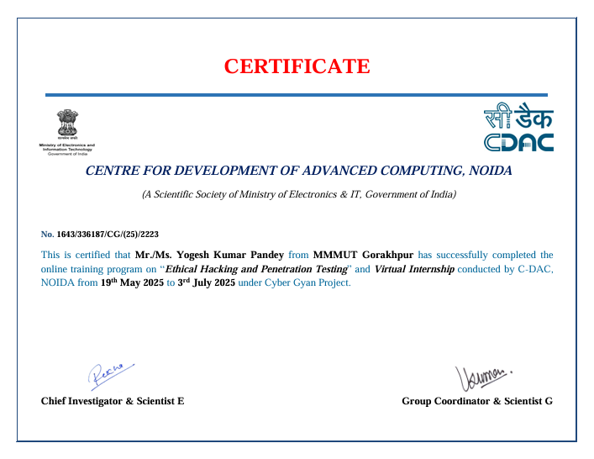
CERTIFICATE

Slide 16
THANKYOU

